Slide 1
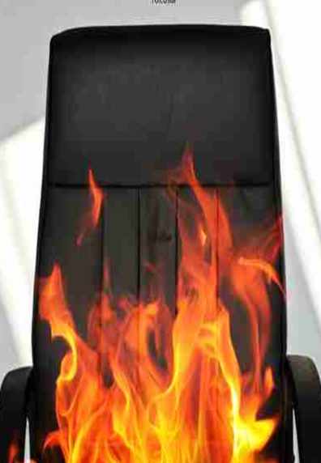
Interview game by jfk Grenoble INP
Hot
Seat
The objectives:
Prepare for interviews
Using the language
Focusing on skills
Controling the pressure
Impressing the interviewers

Slide 2
Interview game
Hot
Seat
Place the cards face down on the table.
Each player has a paper grid to assess other players
There is 1 plastic grid per table to score players using chips.
The youngest player starts by placing his plastic grid in the centre of the table and turning over a card.
The player has 10 seconds to think before beginning to speak.
S/He must speak for at least 3 minutes to best answer the question.
The applicant closes his eyes for 10 seconds whilst the Panel scores with chips.
The other players (= PANEL ) place chips on the plastic grid to score the applicant.
At the end of each question the panel fill in their paper scorecards with their comments about how to best answer the questions (on the back). Allow 2 minutes in between questions for this.
ONE round = every player has answered 1 question.
Play at least 2-3 rounds until all the cards have been turned over.

Slide 3
Scoring system
Interview game
Hot
Seat
You are awarded chips by the jury (the other players) depending on your performance.* see 4 colour « pots » per category on your plastic grid.
= +2 points = - 1 point
The other players will note down any specific comments on the back of their paper scorecards and place chips in the pots/categories on your plastic grid.
You keep your won chips on a seperate pile – the player with the most points at the end of the game « wins »
→ Why not add extra questions on slips of paper?

Slide 4
Applicant:
Scorecard: Award chips to the students
Specific expressions
Non-verbal communication
Focus on skills
Examples & anecdotes

Slide 6
Interviewee:
Scorecard: Take notes in the boxes
Specific expressions
Non-verbal communication
Focus on skills
Examples & anecdotes
Turn over the sheet to add further comments

Slide 7
Comments on specific questions asked
Questions asked – note them down …
What would you focus on in answer to them?
Turn over the sheet to add further comments

Slide 8
Tell me about
yourself …
Game name
What do you
feel you have
to offer a
company?
Talk to me
about your
team skills..
Talk to me
about a
project you
were involved
In …
Tell me about
a time you
had to handle
criticism,
direction or
stress ..
Tell me about
one of your
achievements
What are your
short-term
ambitions?
What does
working in an
international
context inspire
in you?
What are your
personal
interests
outside of
work?
How are your
management
& leadership
skills?
How do you
see the future
of your sector?
Give three
questions you
would ask
at the end ..
and why …
Which
adjectives
describe you
best?
Speak to me
about a failure
you
experienced …
What’s the most
difficult
situation you
have had to
handle so far?

Slide 10
Why should
we hire YOU ?
Game name
What’s your
greatest
strength ?
What’s your
greatest
weakness ?
What
motivates you
the most?
What do you
look for in
a job?
Why did you
choose to
become an
engineer ?
Which main
challenges do
expect to face
in your job?
Tell me about
a time you had
to manage
conflict in a
team…
Which
technical skills
do you have
to offer?
How has your
training
prepared you
for this job?
What do you
look for in an
employer?
What are your
PR skills like?

Slide 12
Teacher tips
Plastify
at least 1 grid per team/table of 4-5 students.
At least 10-15 smile/frown chips for each player
Use whiteboard marker on plastified grids.
Add extra questions to the cards.
Move the layout on slides 9-12 if your printer settings are not calibrated.
Do NOT cut directly around the flaming chair symbol – evenly cut cards on the question sides.
Adjust rules depending on student feedback …
Walk around tables noting down feedback points for the end of the activity.

