Slide 1
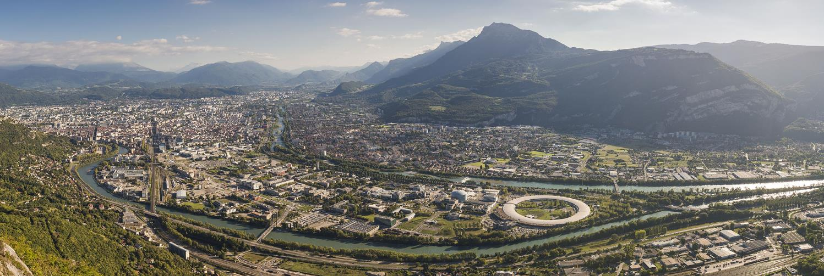

Research, innovation and training
In a cutting edge environment
13th February, 2018

Slide 2
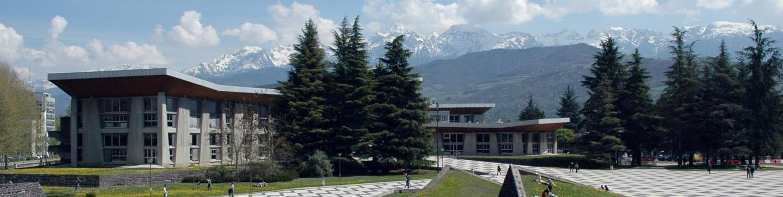
UNIV. GRENOBLE ALPES
Welcome to the Univ. Grenoble Alpes, a unique amalgam of higher education institutes and research organizations collaborating in a region exceptionally rich in scientific advancement and business ventures.

Slide 3
SUMMARY
Grenoble Alpes Ecosystem
Univ. Grenoble Alpes: University of innovation
Living in Grenoble

Slide 4
Chapter 1
Grenoble Alpes Ecosystem

Slide 5
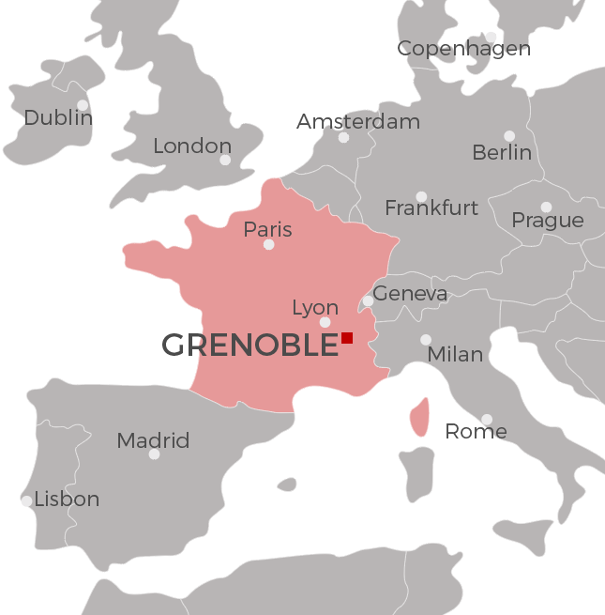
AT the heart of Europe
1
Grenoble
3h by train from Paris
1h40 by car from Geneva
Dynamic environment
Population: 500,000
65,000 students,
15% of which foreigners
European labs & instruments

Slide 6
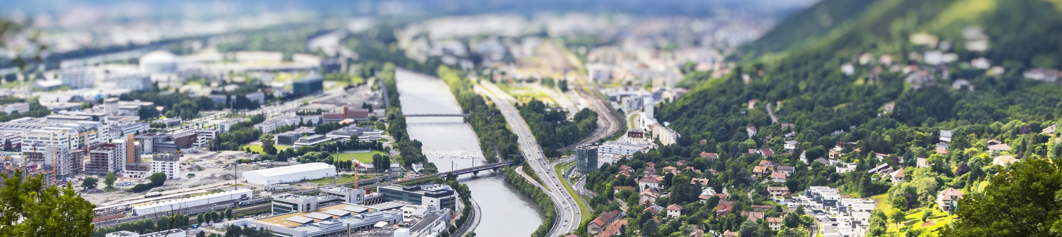
1
INNOVATION ECOSYSTEM
Grenoble, City of Innovation
  7.1% of the population works in R&D (2nd in France)
  5th most inventive city in the world (Forbes 2013)
  3rd European city of the future (The Financial Times)
  Top finalist for the European iCapital “Capital of Innovation Awards” (2014)
  84th most innovative university in the world (Thomson Reuters 2015)
A Wealth of Thriving Businesses
  Over 470 international companies in Grenoble and 78,000 companies in the Isère area

Slide 7
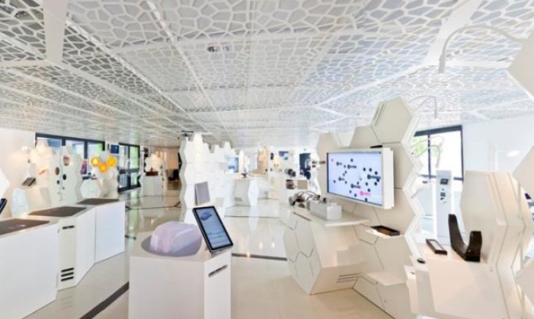
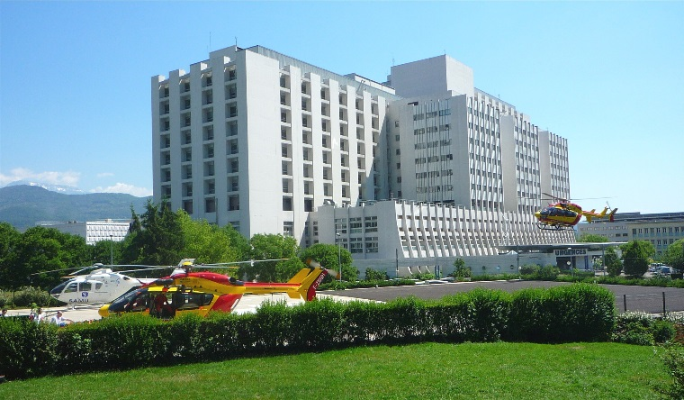
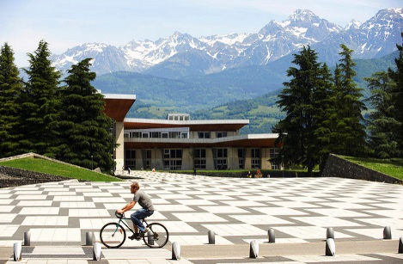
A university firmly grounded in its city
1
3 campus sites in Grenoble
  The growth of the city and territory of Grenoble echoes the dialogue of research, science and industry
  From the glove industry to hydroelectricity (the “houille blanche”), and now micro- and nanotechnologies, software and energy, Grenoble follows the rhythms of innovation.
GIANT campus
Health & well-being campus
East campus
Notes:
The growth of the city and territory of Grenoble echoes the dialogue of research, science and industry.
From the glove industry to hydroelectricity (the “houille blanche”), and now micro- and nanotechnologies, software and energy, Grenoble follows the rhythms of innovation.

Slide 8
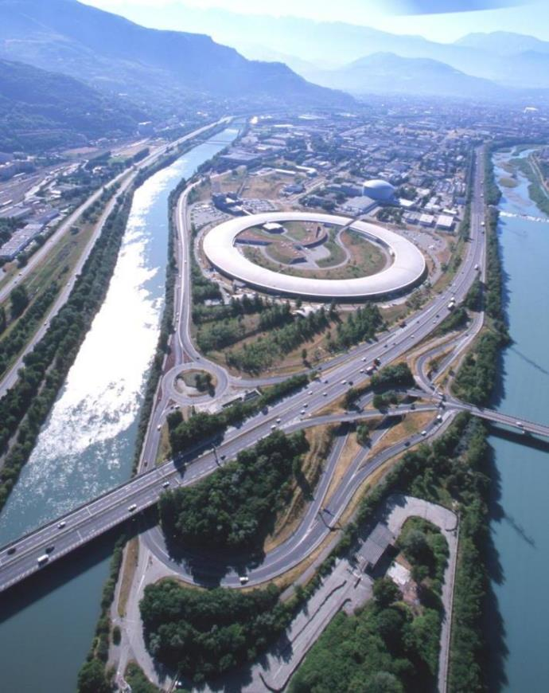
An exceptional environment
1
5 International laboratories and instruments
  ESRF, ILL, EMBL, GHMFL, IRAM
9 National research organizations
  CNRS, CEA, Inria, Inserm, Irstea, INRA, CRSSA, IRD, CEN/CNR
R&D business partners
  Sun Microsystems, HP, Orange, STMicroelectronics, Schneider Electric, Alstom, Xerox, Thales…
Notes:
ESRF: European Synchrotron Radiation Facility
ILL: Institut Laue Langevin Neutron-flux reactor
EMBL: European Molecular Biology Laboratory
GHMFL: Grenoble High Magnetic Field Laboratory
IRAM: Institute of millimetric Radio astronomy

Slide 9
Chapter 2
Univ. Grenoble Alpes
  What is Univ. Grenoble Alpes?
  Research
  Education
  International strategy

Slide 10
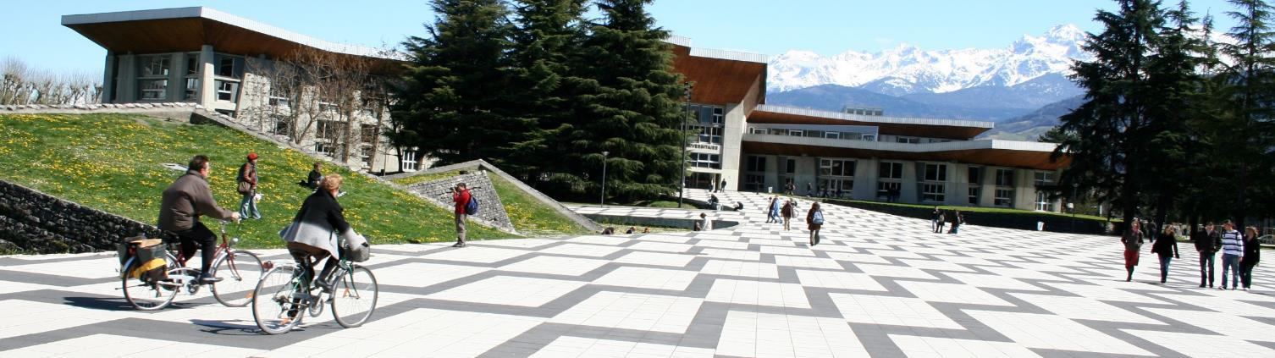
Univ. Grenoble alpes
2
Key figures
  1 university, 3 higher education schools, 5 research centers, 1 teaching hospital
  50,000+ students
  3,700 doctoral students, of which 45% international
  12,000 employees, of which 5,500 academic

Slide 11
Univ. Grenoble alpes’ values
2
Univ. Grenoble Alpes is committed to producing new knowledge that serve humanity and preserve our planet.
Univ. Grenoble Alpes laboratories address audacious scientific problems and major socio-economic challenges that they approach in an open and free spirit delivering innovative solutions
Imagine the unthinkable and dare the impossible for a generous and open world!

Slide 12

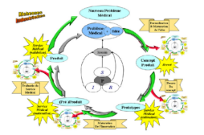
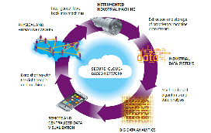

WORLD-CLASS UNIVERSITY
2
2 goals
  develop human & social sciences
  develop interdisciplinarity while enhancing excellence in academic fields
4 socio-economic challenges
Sustainable development & society
Health, well-being
and technology
Digital Technology
Innovation

Slide 13
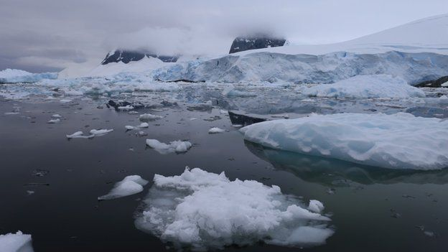
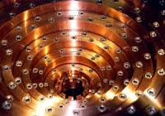
Examples of our Ambitious projects
2
Ice Memory Project
Science in high magnetic
fields@Grenoble

Slide 14



2
INTERNATIONAL RANKINGS
Shanghai 2017
43rd in Environmental and in Material Sciences
Top 50 in Physics, Chemistry,
Top 75 in Nanoscience & Nanotechnology, Electrical & Electronic Engineering, Earth Sciences, and Ecology
Top 100 in Maths
QS World Ranking
Top 100 best universities in the world for Material Sciences
Top 200 for Electrical Engineering, Physics, Environmental Sciences and Linguistics
  5th in France’s “Best Global Universities” (US News and World Report)
  84th “Most Innovative University in the World” (Thomson Reuters 2015)
Notes:
Shanghai 2018: Top 200 Best universities in the world (Grenoble 1 173)
Times Higher Education 2018 Top 200 best universities (UGA 161-170)

Slide 15
Chapter 2
Univ. Grenoble Alpes
  What is Univ. Grenoble Alpes?
  Research
  Education
  International strategy

Slide 16


Research at Univ. GRENOBLE ALPES
2
Mathematics and ICT
  740 faculty members
  500 PhD students
Chemistry, Biology and Health
  730 faculty members
  550 PhD students
Associated Applied Research Institutes:
Physics, Engineering, Materials
  971 faculty members
  1200 PhD students
Law, Politics, Economy, Management, Social Sciences
  370 faculty members
  550 PhD students
1,300 faculty
Particles, Astrophysics, Geosciences, Environment and Ecology
  500 faculty members
  400 PhD students
Arts, Literature, Languages,
Humanities, Cognition
  500 faculty members
  640 PhD students
700 faculty

Slide 17
Cross Disciplinary programs (CDP): an important research asset
2
Support ambitious interdisciplinary research programs that:
  Bring together researchers from different disciplines and departments
  Focus on ambitious scientific and socio-economic problems
  Contribute to the visibility of Univ. Grenoble Alpes, its international policy and attractivenes
7 projects in 2016
  Data@UGA, Eco-SESA, GLYCO@ALPS, LIFE, NeuroCoG, QuEng, Trajectories
  11.9M€ total funding, 128.7M€ consolidated budget
10 projects in 2017
  12.3M€ total funding

Slide 18
Chapter 2
Univ. Grenoble Alpes
  What is Univ. Grenoble Alpes?
  Research
  Innovation
  Education
  International strategy

Slide 19
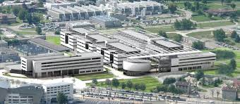
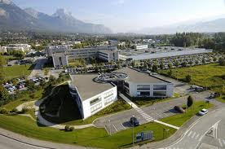
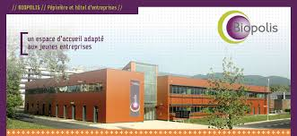
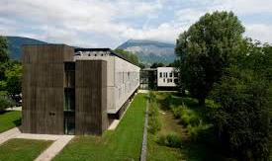
Innovation Parks and Facilities:
Services and technology platforms
2
Minatec
Inovallée
Biopolis
Nanobio
Notes:
Minatec: 2,400 researchers, 1,200 students, and 600 technology transfer experts

Slide 20
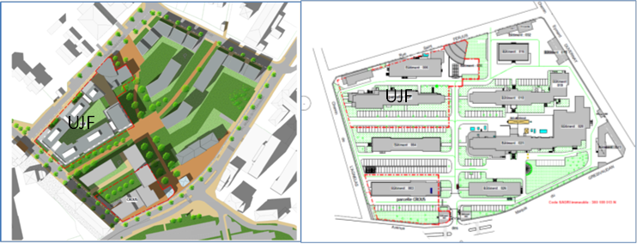
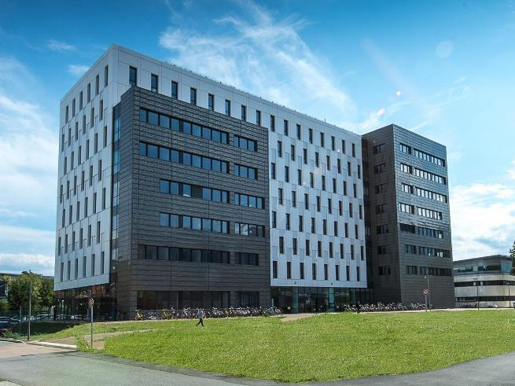
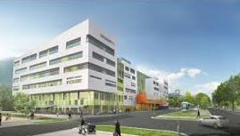
Innovation Parks and Facilities:
Services and technology platforms
2
IMAG: Informatics, Mathematics, Application @ Grenoble
(1,000 researchers)
CIPH: Centre for Personalized & Integrative Health
GreenEr: Energy
Notes:
Funding: more than 400 Meuros
170 000 new m2 dedicated to Innovation, research and education

Slide 21



2
Innovation Through Collaborative projects
ICT/Micro and Nanotechnlogies
850M€ financed projects
350 companies (73% startups & SMEs)
10 research centers and universities
Biotechnologies, Health
887M€ total financed R&D projects
168 small and middle-sized companies
17 research and clinical centers
Energy
More than 1,6B€ financed projects
260 companies (70% startups & SMEs)

Slide 22
Chapter 2
Univ. Grenoble Alpes
  What is Univ. Grenoble Alpes?
  Research
  Innovation
  Education
  International strategy

Slide 23
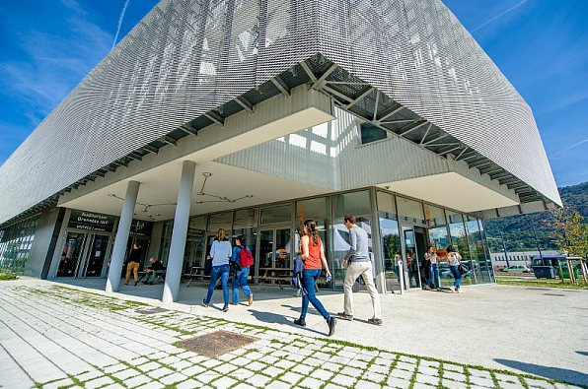
Undergraduate and postgraduate programs in a wide range of disciplines
2
  A comprehensive academic offer:
  Grenoble INP Institut of Enginering Univ. Grenoble Alpes ranked 2nd in France after École Polytechnique

Slide 24

2
An international offer
86 Dual Masters
Law, Economy, Nanotechnologies, Computer Science
International Masters (courses taught in English)
Urbanism, Environment, Energy, Automation, Material sciences, Physics, Chemistry, Computer Science, Nanotechnologies, Health, Applied Mathematics for Industry, Business/Finance, Electrical Engineering, Civil Engineering…
Notes:
Dual Degrees :
UGA : 55
INP : 25
Sciences Po: 6
ENSAG: apparemment 0
MASTERS
10 Masters Biology
3 Masters & 1 Bachelors Energy
6 Masters Engineering
9 Masters Environment
6 Masters & 1 Diploma Health
7 Masters & 4 Certificates Management/Communication/Business
9 Masters & 2 Diplomas Materials / Industrial Engineering
6 Masters Nanotechnologies
7 Masters Chemistry/Physics
9 Masters & 1 Bachelors Applied Mathematics and Computer Science
2 Masters Urbanism
4 Summer Schools

Slide 25
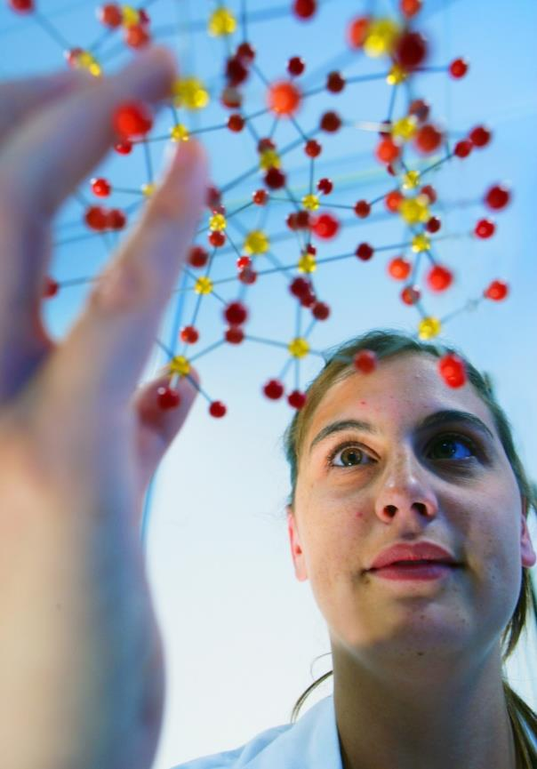
5 top level International schools & Bachelor SP
2
  International Schools
  ERCA: European Research Course on Atmospheres
  ESONN: European School on Nanosciences and NanoTech.
  HERCULES: Higher European Research Course for Users of Large Experimental Systems
  Les Houches Physics School
  Summer School in Mathematics
  Bachelor Summer Program
  Physical Computing
  Large Scale Facilities
  Micro and Nano technology

Slide 26
Our Ambition in education@2020
2
Co-working spaces: 6,000 students
Flipped classrooms: 5,000 students
Student-centered teaching: 30,000 students
Modular multidisciplinary courses: 10,000 students
Bachelor student mentoring: 3,000 students
Learning-by-doing platforms: 10,000 students
Student entrepreneurship: 400 students

Slide 27
2
DOCTORAL COLLEGE
3,700 PhD students, 45% international
14 doctoral schools
105 PhD specialisations
120 structures and research facilities
300 PhD « co-tutelle » students (joint-PhD)
Internationally renowned fields of excellence
  Micro-nano-technologies, Software and Smart Systems
  Fundamental Biology, Medicine, Biotechnologies
  Environmental Engineering
  Energy, Management and Sociology of Innovation
  Etc.

Slide 28
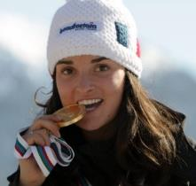
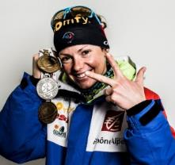
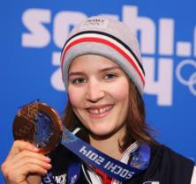

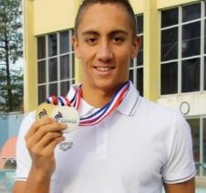
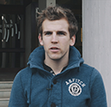
2
HIGH-LEVEL SPORTS STUDENTS
More than 400 high-level sport students welcomed each year
More than hundred finalists' places at the international level
  Marie Brochet
  Four-time medalist in alpine skiing, Paralympic Games in Sotchi
  Marie Dorin-Habert
  Bronze and silver medalist in the biathlon,
  Vancouver Games
  Coline Mattel Olympic bronze medalist in ski-jump,
  Sotchi Games
  Pierre Vautier
  Olympic gold medalist in snowboard cross, Sotchi Games
  Jordan Pothain
  Gold medalist 400m freestyle
  Silver medalist 200m freestyle,
  Rio Games
  Clément Duret
  Silver medalist, World Rowing Championships

Slide 29
Chapter 2
Univ. Grenoble Alpes
  Introduction
  Research
  Education
  International strategy

Slide 30

2
LONG TRADITION OF INTERNATIONAL EXCHANGE
Personalized help and assistance
  International Students and Scholars Office (ISSO)
On-campus immigration office
Language and culture courses designed specifically for exchange students
One of the oldest university centers for the study of French: CUEF
An international student association: IntEGre

Slide 31
ISSO
2
International Students and Scholars Office
Practical information, assistance and support for students, PhD students, international researchers and their families in settling into Grenoble life and throughout their stay
International Students and Scholars Office
Visas
Housing
Admin. procedures
Integration & Family

Slide 32
International Policy
2
Our goal is to:
  Develop and support our participation in international research structures
  Develop a limited number of strategic partnerships with institutions that share similar priorities in research, innovation and education
  Position Univ. Grenoble Alpes as a major partner in the ecosystem and innovation strategy in Europe, fully involved in defining roadmaps and calls for European projects

Slide 33
Chapter 3
Living in Grenoble

Slide 34
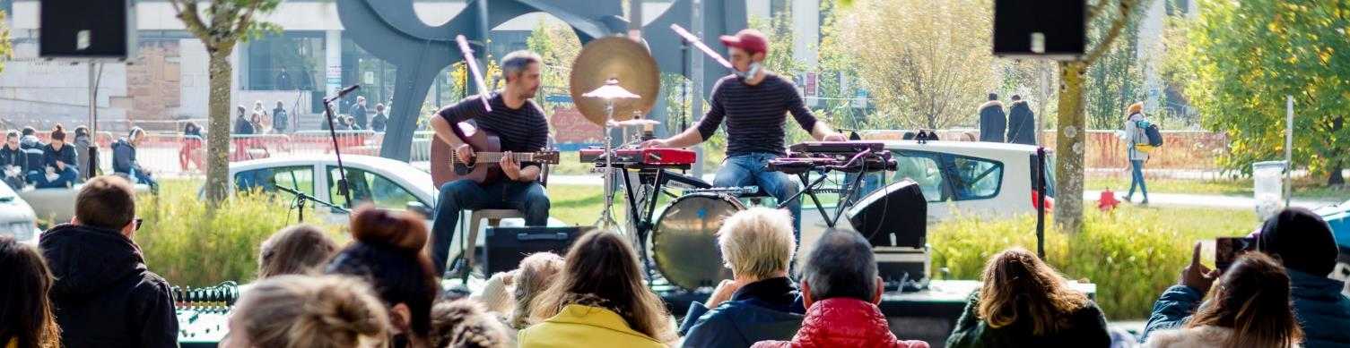
3
ONE OF THE BEST STUDENT CITIES IN FRANCE
A dynamic student life
  Sport infrastructures: olympic swimming pool, climbing walls, sport halls and grounds…
  Student centre on Grenoble campus (EVE)
  More than 200 student organisations, a student radio
  400 cultural events programmed each year for students
A campus health center
Easily accessible by bus, tram, or bike

Slide 35
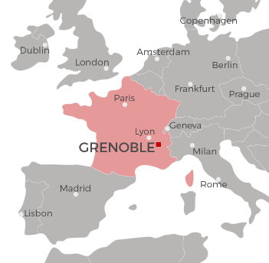
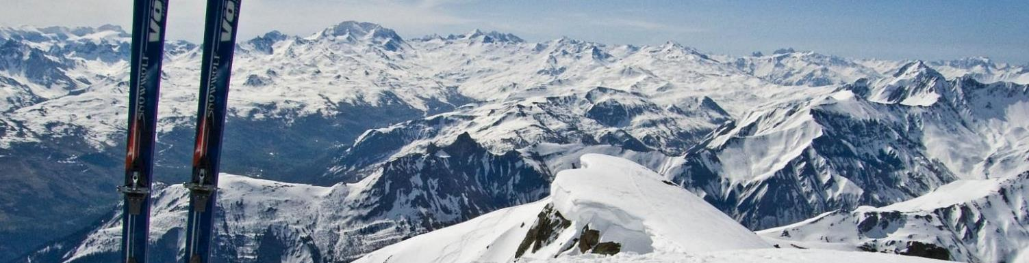
3
EXTREMELY ATTRACTIVE LOCATION
At the crossroad of Europe
  Easy access from Paris (3 hours by train), the Mediterranean Coast, Switzerland, Italy, with 3 nearby airports
Grenoble is nestled in the Alps
  Close proximity to 30 ski resorts, wildlife reserves and national parks
  Near the highest mountain peaks in the Western Alps: Mont-Blanc, Vanoise range, Ecrins
One of the most beautiful green campuses in Europe
French capital of mountain sports and outdoor activities

Slide 36
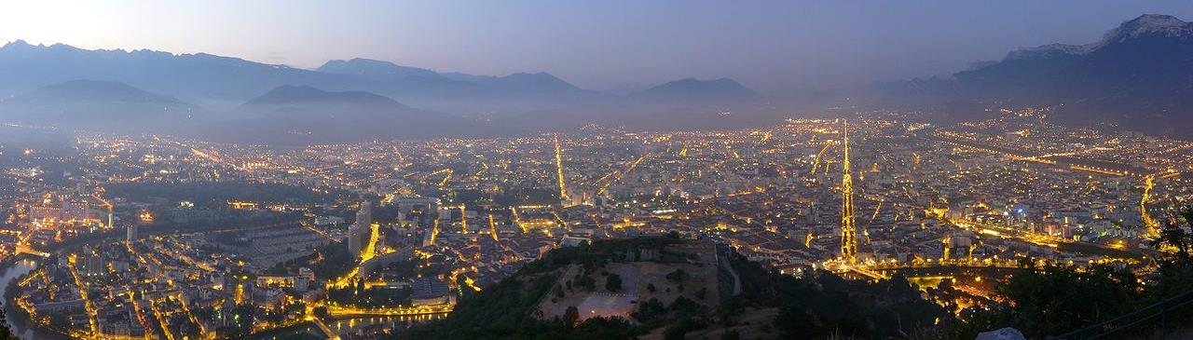
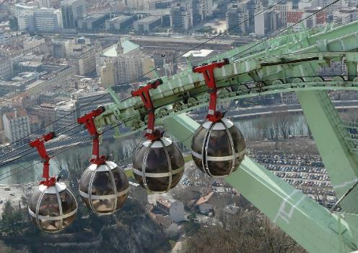
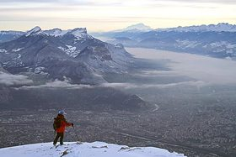
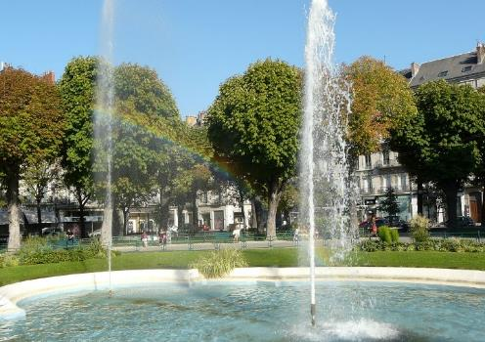
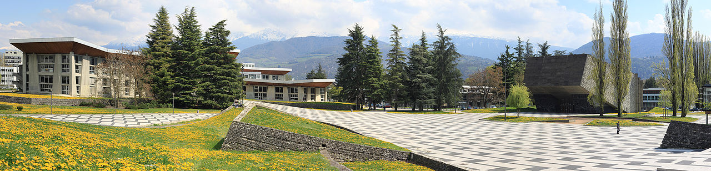
a
© Matthieu Riegler, CC-BY

